Slide 1
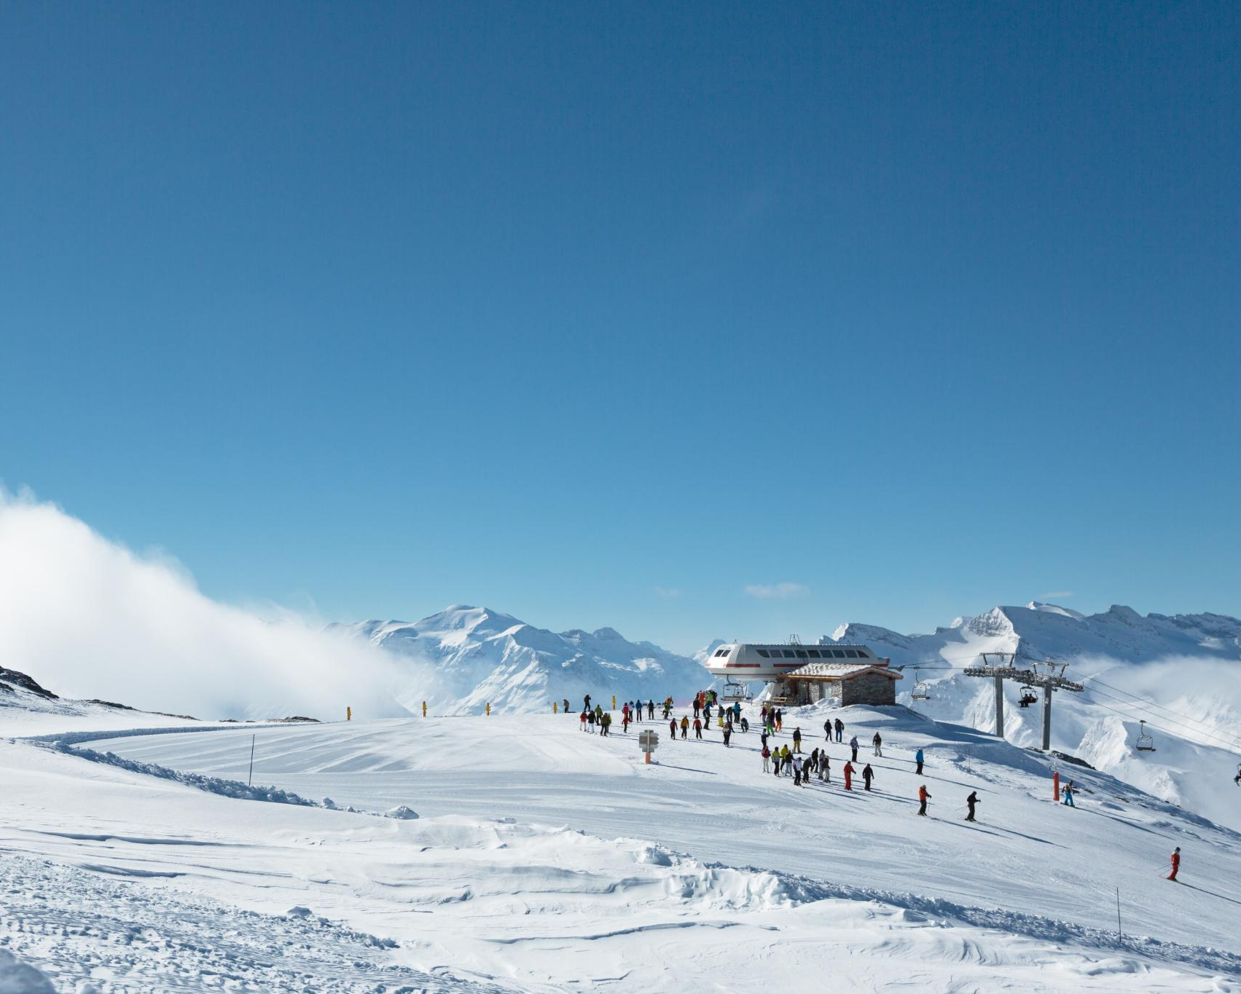
Data Analysis Summary for Big Mountain Ski Resort: Evaluating the Justification for a Premium Pricing Strategy
ASSESSING FINANCIAL PERFORMANCE AND PRICING STRATEGIES
BY SANJAY PATEL

Slide 2

Agenda Highlights
Introduction to Big Mountain Ski Resort
Current Financial Challenges
Data-Driven Pricing Strategy
Scenario Analysis for Pricing Adjustment
Impact and Recommendations

Slide 3
Introduction to Big Mountain Ski Resort

Slide 4

Overview of the Resort
Stunning Landscapes
Big Mountain Ski Resort is renowned for its breathtaking landscapes that attract 350,000 visitors throughout the seasons.
Diverse Terrain
Big Mountain offers one of the highest vertical drops, extensive snow making, numerous chairs and runs, the longest run, and substantial skiable terrain.
Visitor Facilities
Big Mountain Ski Resort offers a one of the best facilities in numerous facilities nationwide.

Slide 5
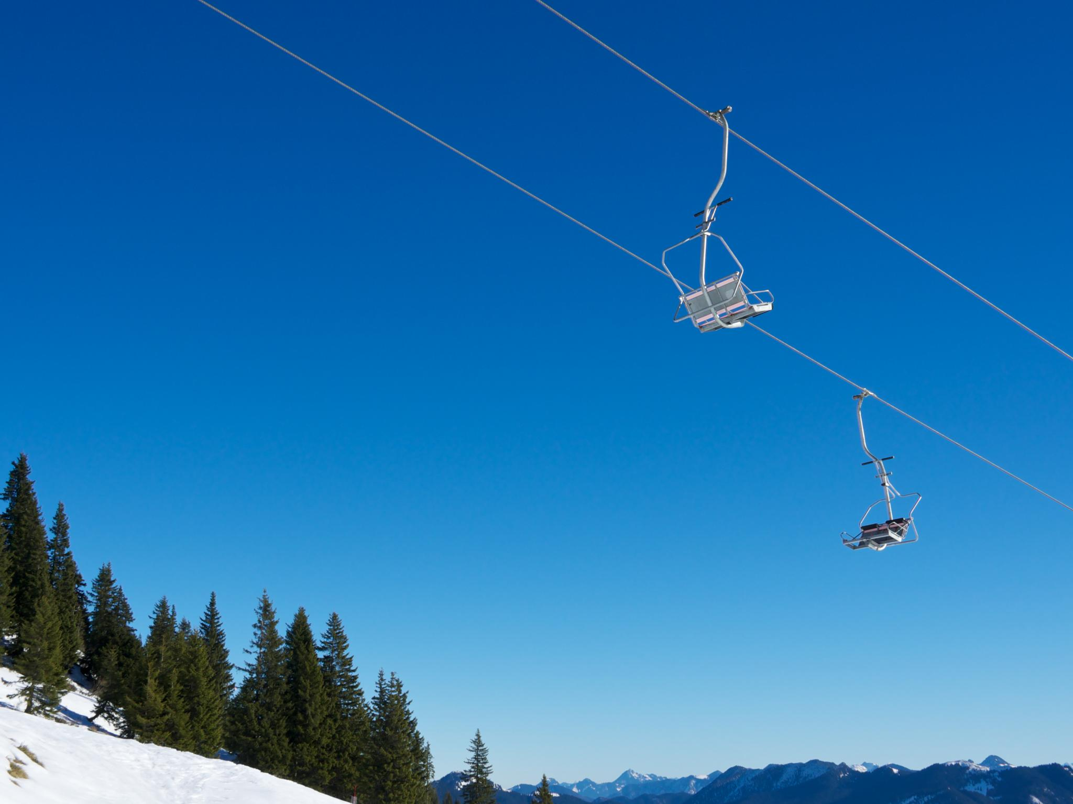
Current Facilities and Features one of the best nationwide.
Category | Percentile Score Nationwide
fast Quads | 93.50%
quad chairs | 81.77%
triple chairs | 98.01%
total chairs | 94.04%
Number of Runs | 93.07%
Terrain Parks | 82.83%
Longest Run | 95.96%
Skiable Terrain | 98.36%

Slide 6

Visitor Demographics and Statistics
Visitor Demographics Overview
Visitor demographics include a diverse mix of locals and tourists, each with unique preferences and needs.
Skiing Preferences
Analyzing preferences for skiing among visitors helps in tailoring services and experiences to meet their expectations.
Market Analysis for Pricing
Understanding visitor statistics is crucial for developing effective pricing strategies that cater to the target market.

Slide 7
Current Financial Challenges

Slide 8

Increased Operating Costs
Rising Operational Expenses by $1.5 Millions
Recent improvements, including the addition of a chair lift, have led to increased operating costs exceeding $1.5 million for the current season
Current Ticket Price
$81 for both weekdays and weekends.
Is Increased Ticket price justifiable?
By leveraging a data-driven business strategy, the company aims to determine whether it is justifiable to raise the average ticket price by $5 to offset the higher operating expenses and sustain profitability.

Slide 9

Need for Cost Reduction or Price Increase
Financial Challenges
The resort is facing significant financial challenges that require immediate attention to ensure sustainability.
Cost Reduction Strategies
Should we drop or close some facilities? Or Increase facility? How will it impact ticket price and revenue.
Price Increase Considerations
Evaluating the effects of increasing prices on revenue generation is crucial for strategic decision-making.

Slide 10
Data-Driven Pricing Strategy

Slide 11

Development of an Optimal Pricing Model
Recommendation
The current price for Big Mountain Resorts is $81 per ticket1. The model's recommended price is $95.87. Considering the Mean Absolute Error of $10.39, the suggested new price range would be $85.87 to $105.87.
Current Price | Recommended Price | Mean Absolute Error | Implication
$81 | $95.87 | $10.39 | Increase in ticket prices

Slide 12
Scenario Analysis for Pricing Adjustment

Slide 13

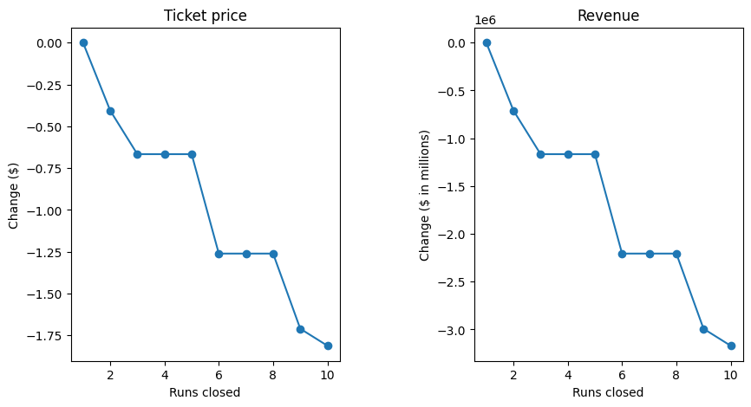
Scenario 1: Testing the Closure of Runs
closing one run makes no difference. Closing 2 and 3 successively reduces support for ticket price and so revenue. If Big Mountain closes down 3 runs,
it seems they may as well close down 4 or 5 as there's no further loss in ticket price. Increasing the closures down to 6 or more leads to a large drop.

Slide 14

Scenario 2: Add Run, Drop,& Lift
Modifications: 1 additional run, increase vertical drop by 150 feet, install 1 chair lift
Expected Increase in Ticket Price: $8.61
Expected Revenue Increase: $15,065,471
.

Slide 15

Scenarios 3 and 4: Snowmaking and Extending Runs
Scenario 3: Add 2 acres of snowmaking
Scenario 4: Extend the longest run by 0.2 miles and add 4 acres of snowmaking capability
No notable changes in ticket prices or revenue

Slide 16
Conclusion
Balancing Pricing and Satisfaction
Data-Driven Insights
Financial Sustainability
The evaluation of premium pricing emphasizes the need to maintain visitor satisfaction while ensuring financial stability for the resort.
Leveraging data-driven insights allows the resort to make informed decisions to address financial challenges efficiently.
The resort must navigate financial challenges while ensuring sustainability for future operations and guest experiences.

